Slide 1
Foundations of Machine Learning
Module 2: Linear Regression and Decision Tree
Part C: Learning Decision Tree
Sudeshna Sarkar
IIT Kharagpur

Slide 2
Top-Down Induction of Decision Trees ID3
1. Which node to proceed with?
A ← the “best” decision attribute for next node
Assign A as decision attribute for node
For each value of A create new descendant
Sort training examples to leaf node according to the attribute value of the branch
If all training examples are perfectly classified (same value of target attribute) stop, else iterate over new leaf nodes.
2. When to stop?

Slide 3
Choices
When to stop
no more input features
all examples are classified the same
too few examples to make an informative split
Which test to split on
split gives smallest error.
With multi-valued features
split on all values or
split values into half.

Slide 4
Which Attribute is ”best”?
[29+,35-]
A₁=?
A₂=?
[29+,35-]
True
False
True
False
[21+, 5-]
[8+, 30-]
[18+, 33-]
[11+, 2-]

Slide 5
Principled Criterion
Selection of an attribute to test at each node - choosing the most useful attribute for classifying examples.
information gain
measures how well a given attribute separates the training examples according to their target classification
This measure is used to select among the candidate attributes at each step while growing the tree
Gain is measure of how much we can reduce uncertainty (Value lies between 0,1)

Slide 6
Entropy
A measure for
uncertainty
purity
information content
Information theory: optimal length code assigns (− log₂p) bits to message having probability p
S is a sample of training examples
p₊ is the proportion of positive examples in S
p₋ is the proportion of negative examples in S
Entropy of S: average optimal number of bits to encode information about certainty/uncertainty about S
Entropy(S) = p₊(−log₂p₊) + p₋(−log₂p₋) = −p₊log₂p₊− p₋log₂p₋

Slide 7
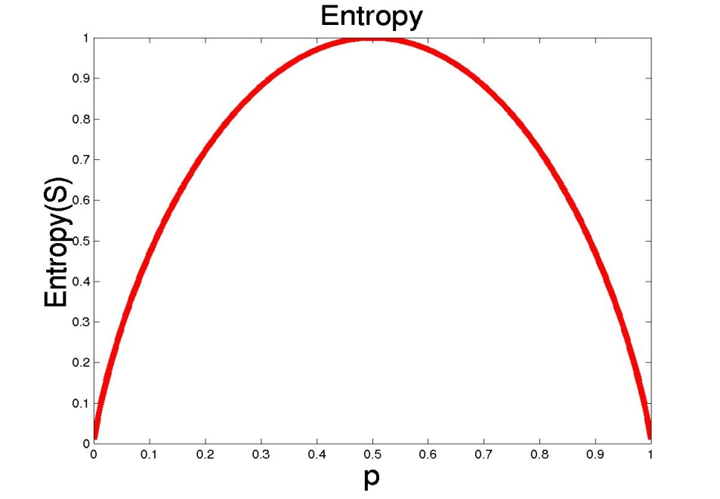
Entropy
The entropy is 0 if the outcome is ``certain”.
The entropy is maximum if we have no knowledge of the system (or any outcome is equally possible).
S is a sample of training examples
p₊ is the proportion of positive examples
p₋ is the proportion of negative examples
Entropy measures the impurity of S
Entropy(S) = −p₊log₂p₊− p₋log₂ p₋

Slide 8
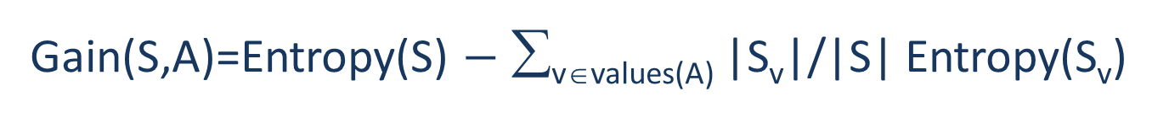
Information Gain
Gain(S,A): expected reduction in entropy due to partitioning S on attribute A
Gain(S,A)=Entropy(S) $−$ ∑_{v∈values(A)} |S_{v}|/|S| Entropy(S_{v})
Entropy([29+,35-]) = -29/64 log₂ 29/64 – 35/64 log₂ 35/64
= 0.99
[29+,35-]
A₁=?
A₂=?
[29+,35-]
True
False
True
False
[21+, 5-]
[8+, 30-]
[18+, 33-]
[11+, 2-]

Slide 9
Information Gain
Entropy([18+,33-]) = 0.94
Entropy([8+,30-]) = 0.62
Gain(S,A₂)=Entropy(S)
-51/64*Entropy([18+,33-])
-13/64*Entropy([11+,2-])
=0.12
Entropy([21+,5-]) = 0.71
Entropy([8+,30-]) = 0.74
Gain(S,A₁)=Entropy(S)
-26/64*Entropy([21+,5-])
-38/64*Entropy([8+,30-])
=0.27
[29+,35-]
A₁=?
A₂=?
[29+,35-]
True
False
True
False
[21+, 5-]
[8+, 30-]
[18+, 33-]
[11+, 2-]

Slide 10
Training Examples
Day | Outlook | Temp | Humidity | Wind | Tennis?
D1 | Sunny | Hot | High | Weak | No
D2 | Sunny | Hot | High | Strong | No
D3 | Overcast | Hot | High | Weak | Yes
D4 | Rain | Mild | High | Weak | Yes
D5 | Rain | Cool | Normal | Weak | Yes
D6 | Rain | Cool | Normal | Strong | No
D7 | Overcast | Cool | Normal | Strong | Yes
D8 | Sunny | Mild | High | Weak | No
D9 | Sunny | Cool | Normal | Weak | Yes
D10 | Rain | Mild | Normal | Weak | Yes
D11 | Sunny | Mild | Normal | Strong | Yes
D12 | Overcast | Mild | High | Strong | Yes
D13 | Overcast | Hot | Normal | Weak | Yes
D14 | Rain | Mild | High | Strong | No

Slide 11
Selecting the Next Attribute
S=[9+,5-]
E=0.940
S=[9+,5-]
E=0.940
Humidity
Wind
High
Normal
Weak
Strong
[3+, 4-]
[6+, 1-]
[6+, 2-]
[3+, 3-]
E=0.592
E=0.811
E=0.985
E=1.0
Gain(S,Humidity)
=0.940-(7/14)*0.985
– (7/14)*0.592
=0.151
Gain(S,Wind)
=0.940-(8/14)*0.811
– (6/14)*1.0
=0.048
Humidity provides greater info. gain than Wind, w.r.t target classification.

Slide 12
Selecting the Next Attribute
S=[9+,5-]
E=0.940
Outlook
Sunny
Overcast
Rain
[2+, 3-]
[4+, 0]
[3+, 2-]
E=0.971
E=0.0
E=0.971
Gain(S,Outlook)
=0.940-(5/14)*0.971
-(4/14)*0.0 – (5/14)*0.0971
=0.247

Slide 13
Selecting the Next Attribute
The information gain values for the 4 attributes are:
Gain(S,Outlook) =0.247
Gain(S,Humidity) =0.151
Gain(S,Wind) =0.048
Gain(S,Temperature) =0.029
where S denotes the collection of training examples
Note: 0Log₂0 =0

Slide 14
ID3 Algorithm
[D1,D2,…,D14]
[9+,5-]
Outlook
Sunny
Overcast
Rain
S_{sunny}=[D1,D2,D8,D9,D11]
[2+,3-]
[D3,D7,D12,D13]
[4+,0-]
[D4,D5,D6,D10,D14]
[3+,2-]
?
Yes
?
Test for this node
Gain(S_{sunny} , Humidity)=0.970-(3/5)0.0 – 2/5(0.0) = 0.970
Gain(S_{sunny} , Temp.)=0.970-(2/5)0.0 –2/5(1.0)-(1/5)0.0 = 0.570
Gain(S_{sunny} , Wind)=0.970= -(2/5)1.0 – 3/5(0.918) = 0.019

Slide 15
ID3 Algorithm
Outlook
Sunny
Overcast
Rain
Humidity
Yes
Wind
[D3,D7,D12,D13]
High
Normal
Strong
Weak
No
Yes
No
Yes
[D1,D2]
[D8,D9,D11]
[D6,D14]
[D4,D5,D10]

Slide 16
Splitting Rule: GINI Index
GINI Index
Measure of node impurity

Slide 17
Splitting Based on Continuous Attributes

Slide 18
Continuous Attribute – Binary Split
For continuous attribute
Partition the continuous value of attribute A into a discrete set of intervals
Create a new boolean attribute A_{c} , looking for a threshold c,
consider all possible splits and finds the best cut
How to choose c ?

Slide 19
Practical Issues of Classification
Underfitting and Overfitting
Missing Values
Costs of Classification

Slide 20
Hypothesis Space Search in Decision Trees
Conduct a search of the space of decision trees which
can represent all possible discrete functions.
Goal: to find the best decision tree
Finding a minimal decision tree consistent with a set of data
is NP-hard.
Perform a greedy heuristic search: hill climbing without
backtracking
Statistics-based decisions using all data

Slide 21
Bias and Occam’s Razor
Prefer short hypotheses.
Argument in favor:
Fewer short hypotheses than long hypotheses
A short hypothesis that fits the data is unlikely to be a coincidence
A long hypothesis that fits the data might be a coincidence

